Slide 1
Lecture 3: Measure of Dispersion
Jibo He, Ph.D.
Associate Professor
Wichita State University
jibo.he@Wichita.edu

Slide 2
Review from last lecture
Frequency table
Histogram
Frequency polygon
Bar graph / Pie graph
Measure of central tendency
Mode
Median
Mean

Slide 3
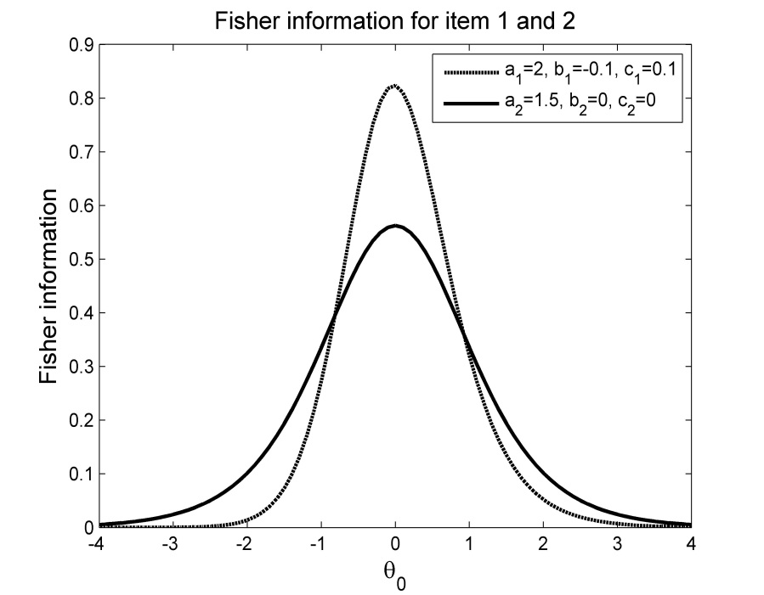
Frequency Distribution: Shape
Symmetric distribution
Mean=median=mode
Bi-modal distribution

Slide 4
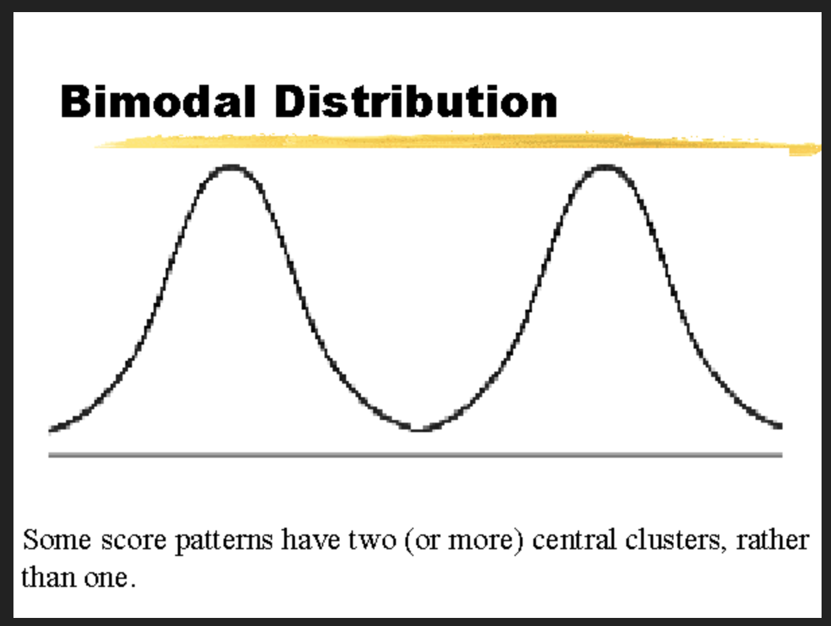
Frequency Distribution: Shape

Slide 5
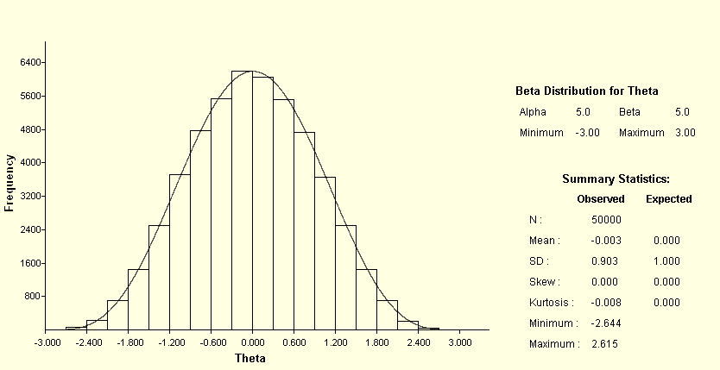

Frequency Distribution
Normal distribution

Slide 6
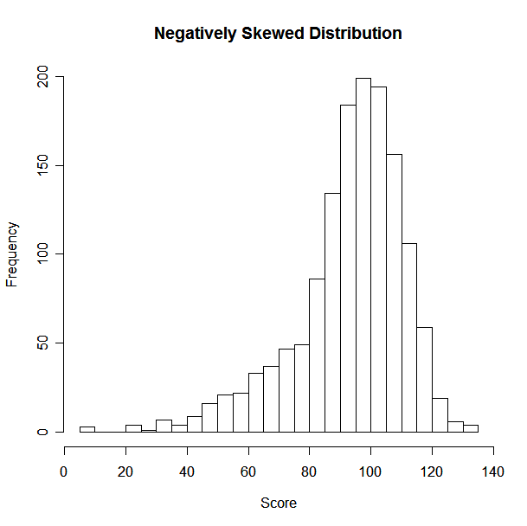
Frequency Distribution
Skew
Skew will be negative when the left tail is longer:
“Skewed to the left”

Slide 7
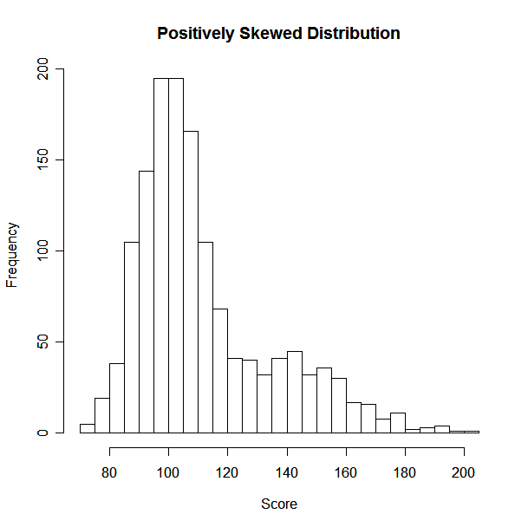
Frequency Distribution
Skew
Skew will be positive when the right tail is longer:
“Skewed to the right”
Notes:
kat4dhey

Slide 8
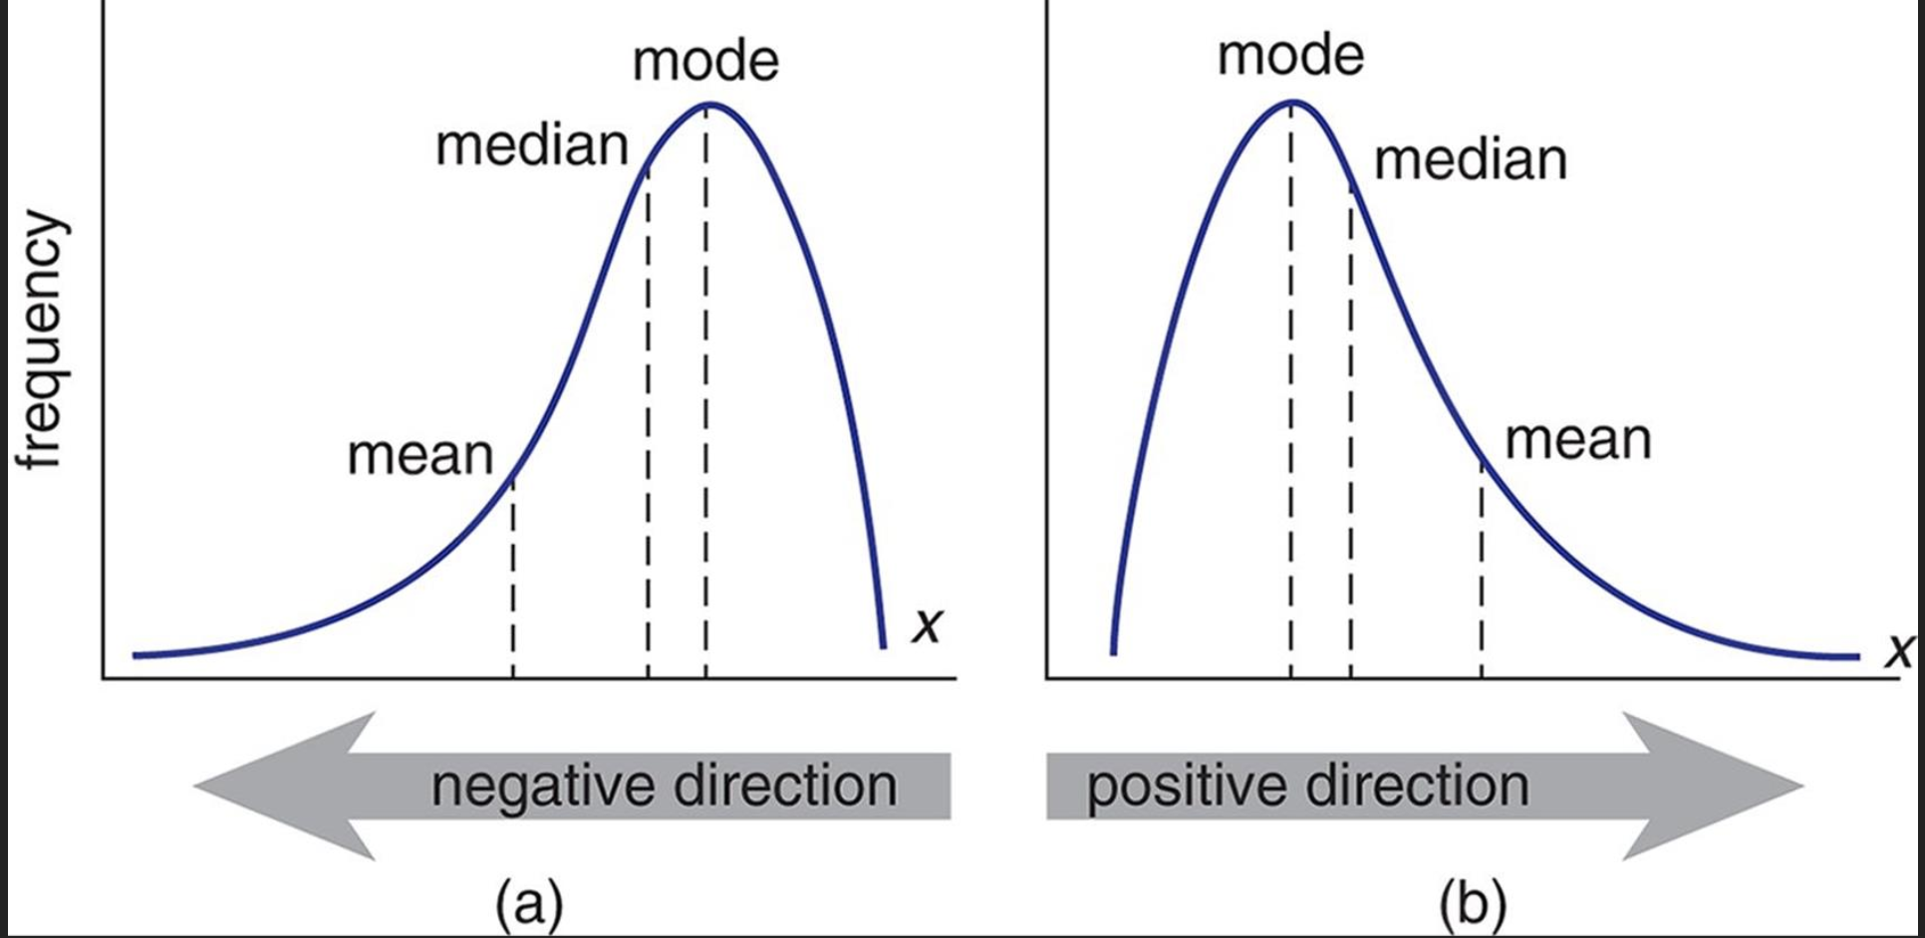
Skewed Distribution
Notes:
kat4dhey

Slide 9
Measures of Dispersion: Range
Range
A simple statement of the highest and lowest scores in a distribution
Test scores 23-98
Incomes $15,000--$70,000
Temperature 62F-81F

Slide 10
Measures of Dispersion: Deviations
Deviations from the mean
The mean deviation
Indexes the degree to which scores in the sample differ with respect to the mean
Deviation scores:
Mean of the deviation scores:

Slide 11
Descriptive Statistics: Spread
Mean absolute deviation (MAD):
Sum of squares
The sum of the squared deviations of the scores about the mean is usually not zero, but it is smaller than the sum of the squared deviations about any other number.

Slide 12
Population Standard Deviation
Variance
Standard deviation

Slide 13
Sample Standard Deviation
Variance
Standard deviation
There are n-1 “degrees of freedom”
(If you know the mean and n-1 observations
then you can figure out the n’th observation)

Slide 14
How to find the variance "by hand”?
Make a table of all x values
Find the mean of the data
Include a column with the difference to the mean
Include a column with the square of difference to the mean
Add the last column and divide the sum by (n - 1).

Slide 15
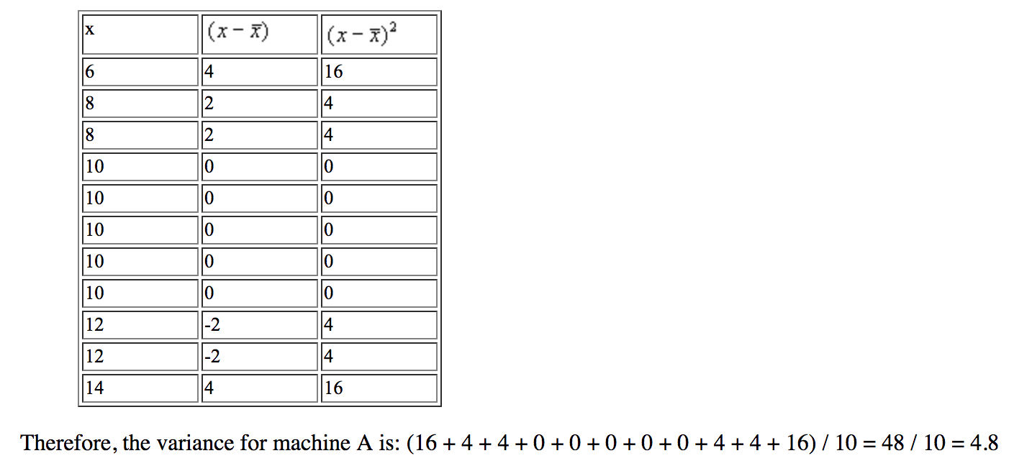
[Exercise] How to find the variance "by hand”?

Slide 16
[Answer] How to find the variance "by hand”?
6 | 4 | 16
8 | -2 | 4
8 | -2 | 4
10 | 0 | 0
10 | 0 | 0
10 | 0 | 0
10 | 0 | 0
10 | 0 | 0
12 | 2 | 4
12 | 2 | 4
14 | 4 | 16
Source: http://pirate.shu.edu/~wachsmut/Teaching/MATH1101/Descriptives/variability.html

Slide 17
[Hands-on] using excel to calculate dispersions
Excel Statistics 04: Calculating Variance and Standard Deviation
https://www.youtube.com/watch?time_continue=44&v=T5GNbSgg9lw

Slide 18
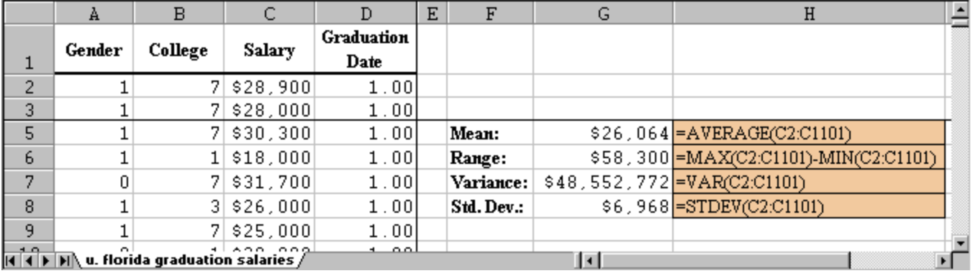
[Hands-on] using excel to calculate dispersions
Using Excel to compute Range, Variance, and Standard Deviation
Excel provides simple formulas to compute the range, the variance, and the standard deviation:
the Excel formula to compute the range is "=max(RANGE) - min(RANGE)"
the Excel formula to compute the variance is "=var(RANGE)"
the Excel formula to compute the standard deviation is "=stdev(RANGE)”

Slide 19
[Hands-on] using R to calculate dispersions
R tutorial : Basic Statistics ( mean, median, standard deviation and variance)
https://www.youtube.com/watch?time_continue=1&v=MyGBZf9LWbs

Slide 20
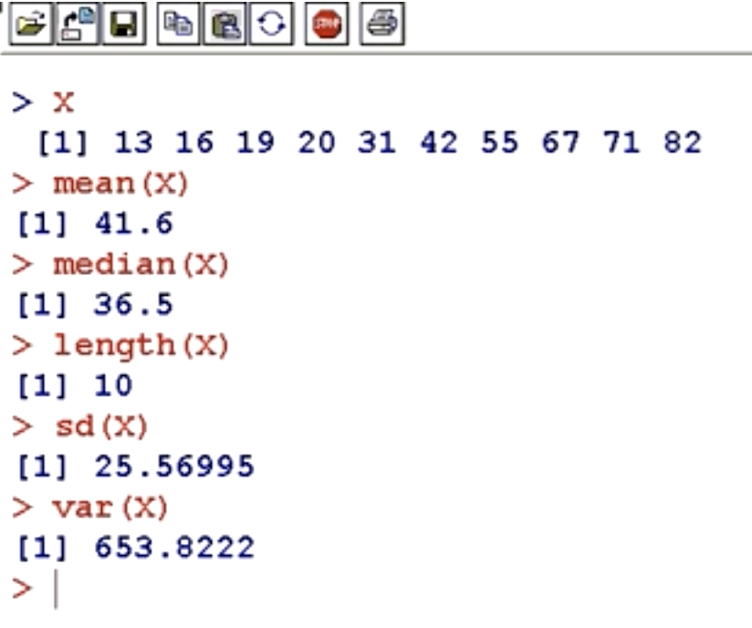
[Hands-on] using R to calculate dispersions
R tutorial : Basic Statistics ( mean, median, standard deviation and variance)

Slide 21
[Hands-on] using SPSS to calculate dispersions
SPSS for newbies: how to get mean, median, mode, standard deviation etc?
https://www.youtube.com/watch?v=J3ax2c4s8Tghttps://www.youtube.com/watch?v=J3ax2c4s8Tg

Slide 22
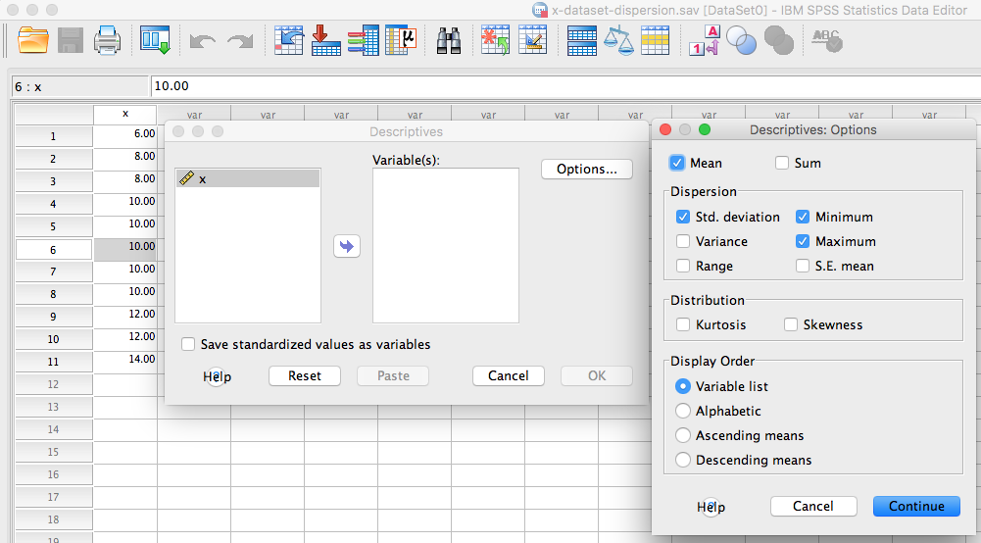
[Hands-on] using SPSS to calculate dispersions

Slide 23
[Hands-on] using SPSS to calculate dispersions
SPSS Syntax
DATASET ACTIVATE DataSet0.
DESCRIPTIVES VARIABLES=x
/STATISTICS=MEAN SUM STDDEV VARIANCE RANGE MIN MAX SEMEAN KURTOSIS SKEWNESS.

Slide 24
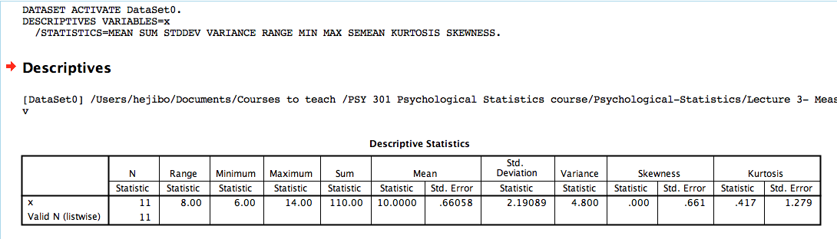
[Hands-on] using SPSS to calculate dispersions
SPSS Output

Slide 25
Summary of Concepts
Range
Deviation
Spread
Variance
Standard deviation

